Slide 1
Dense Passage Retrieval for Open-Domain Question Answering
Vladimir Karpukhin, Barlas Oğuz, Sewon Min, Patrick Lewis, Ledell Wu, Sergey Edunov, Danqi Chen, Wen-tau Yih
Facebook AI University of Washington Princeton University

Slide 2
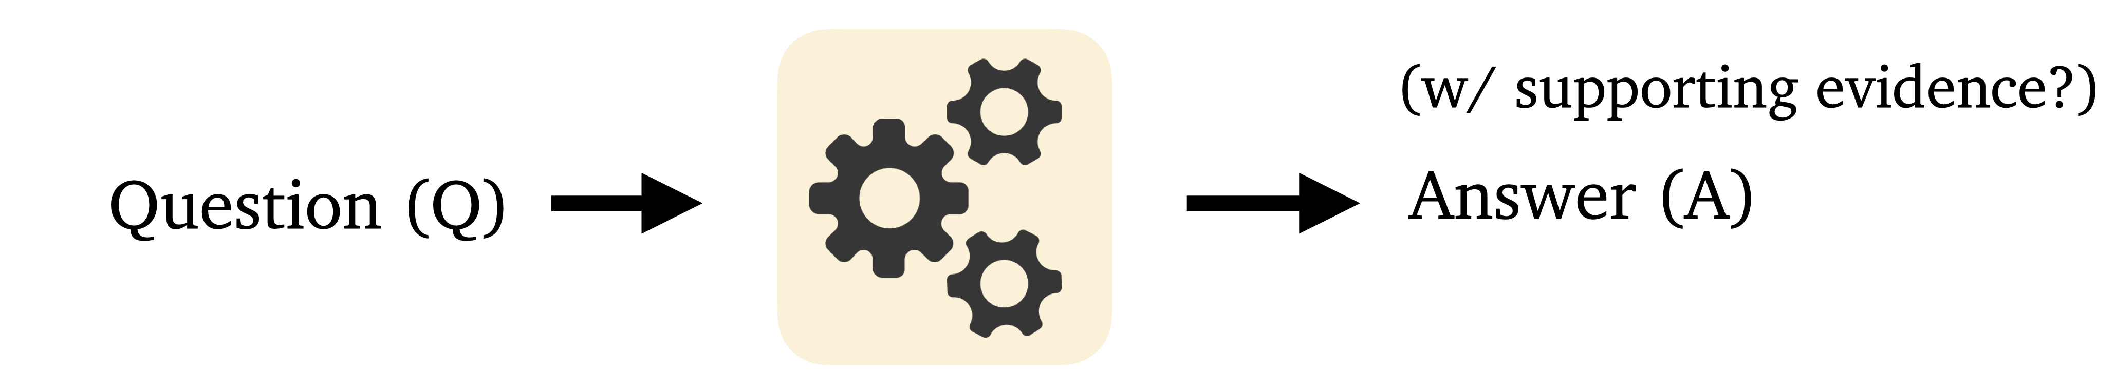
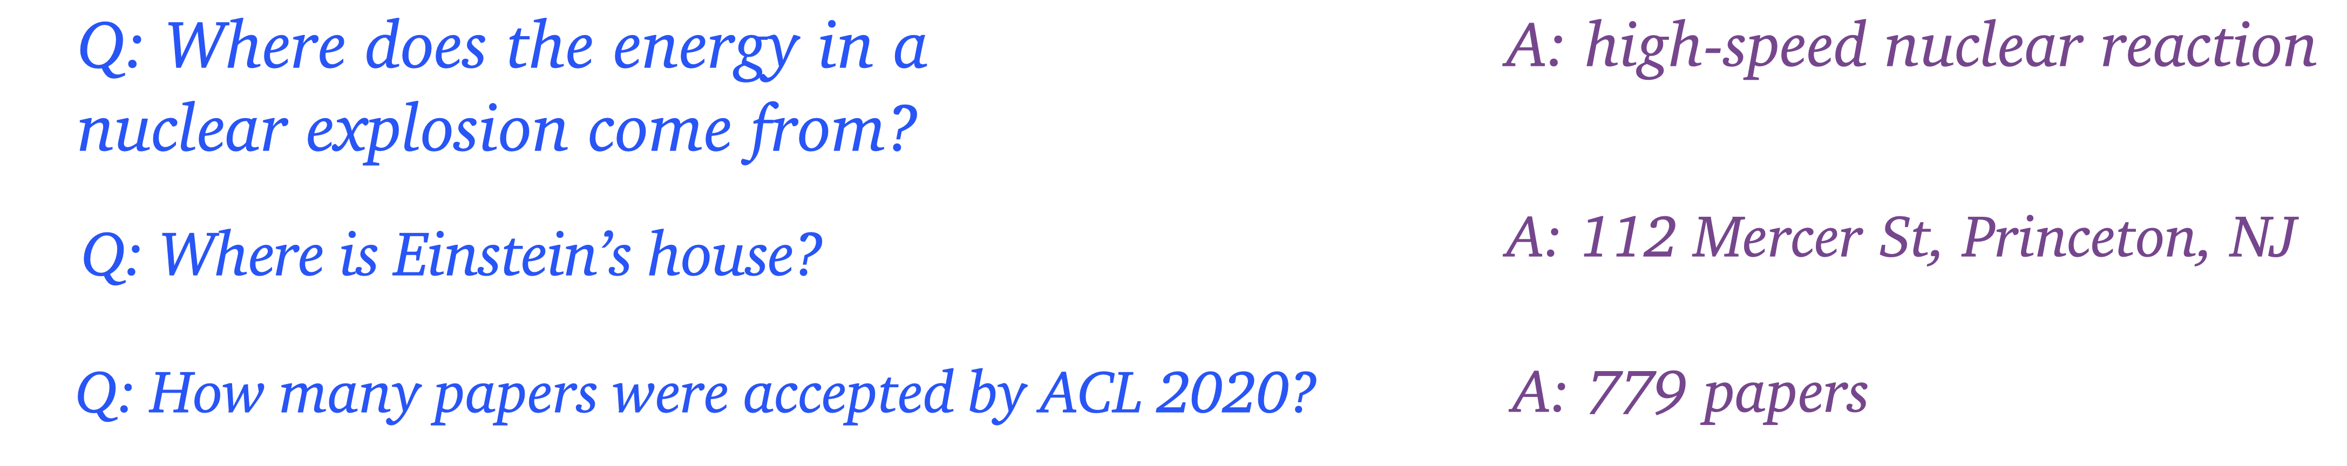
Open-Domain Question Answering
Question answering = build computer systems that automatically answer questions posed by humans in a natural language
Open-domain = deal with questions about nearly anything, usually rely on general ontologies and world knowledge
https://github.com/danqi/acl2020-openqa-tutorial

Slide 3
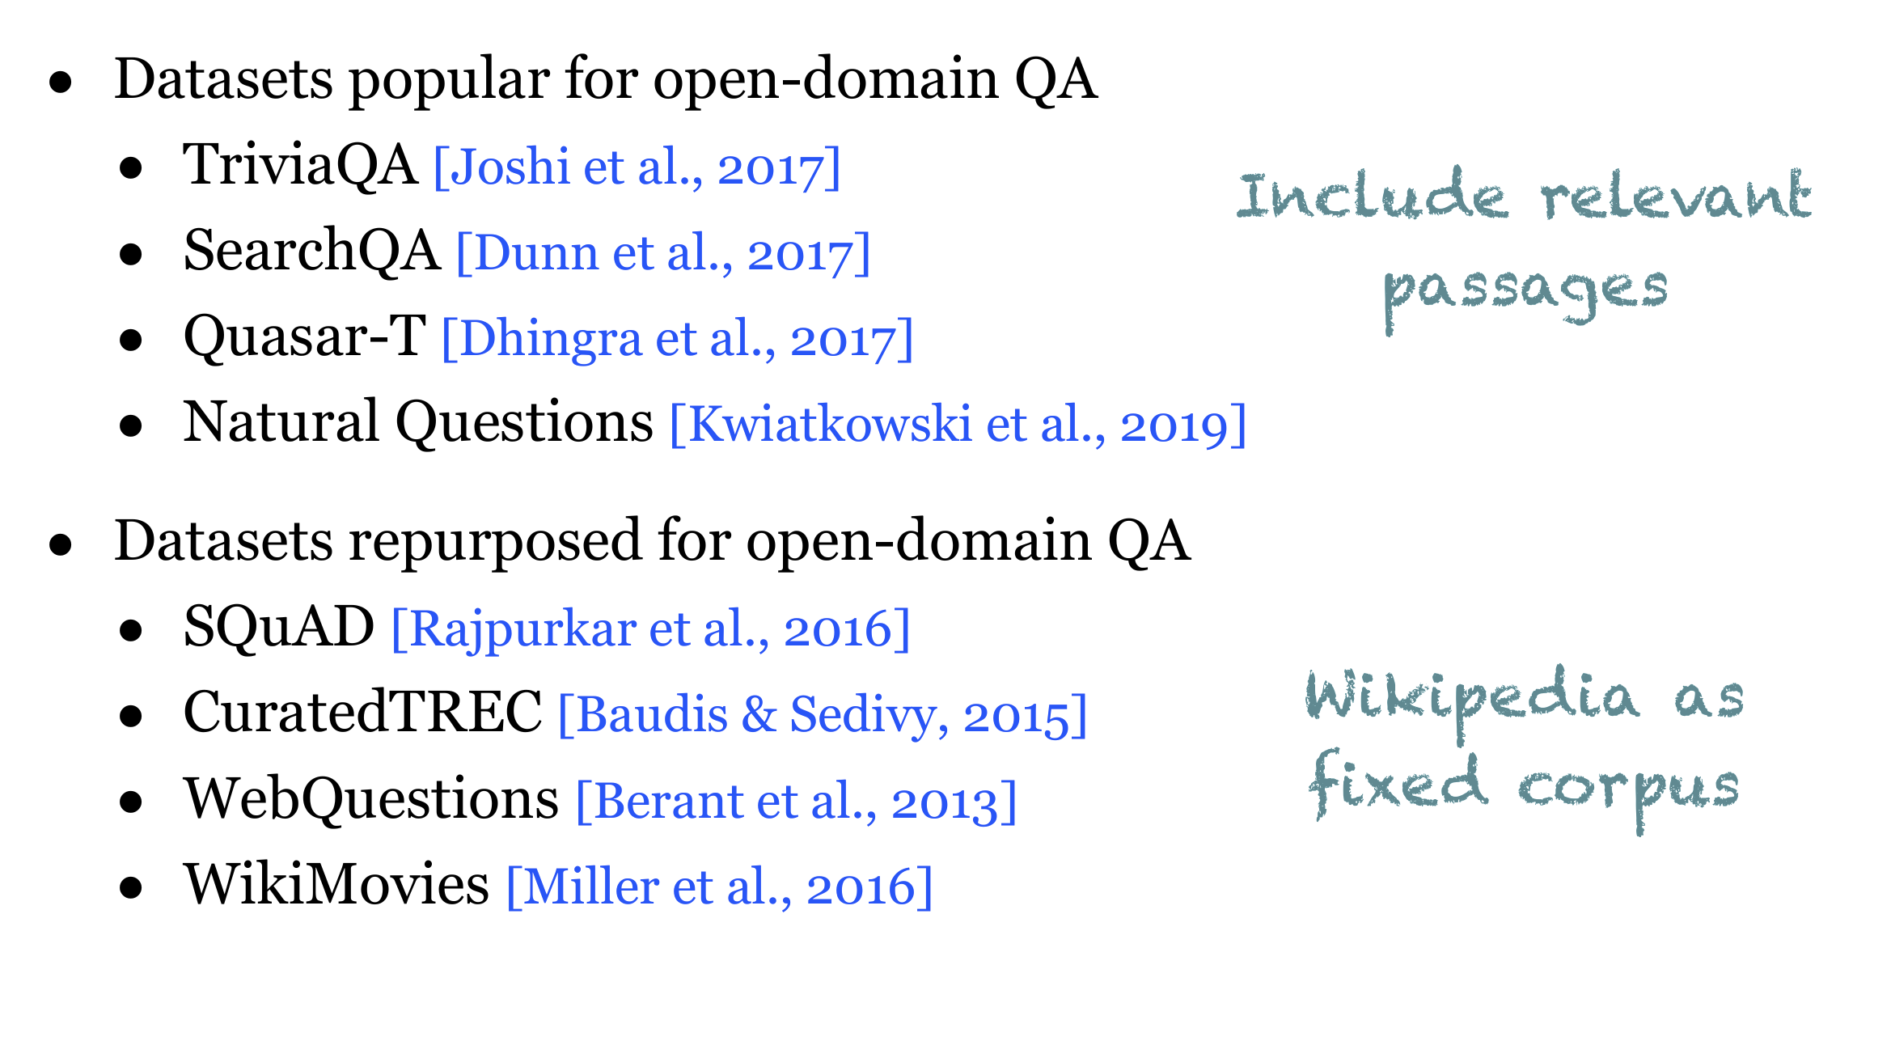
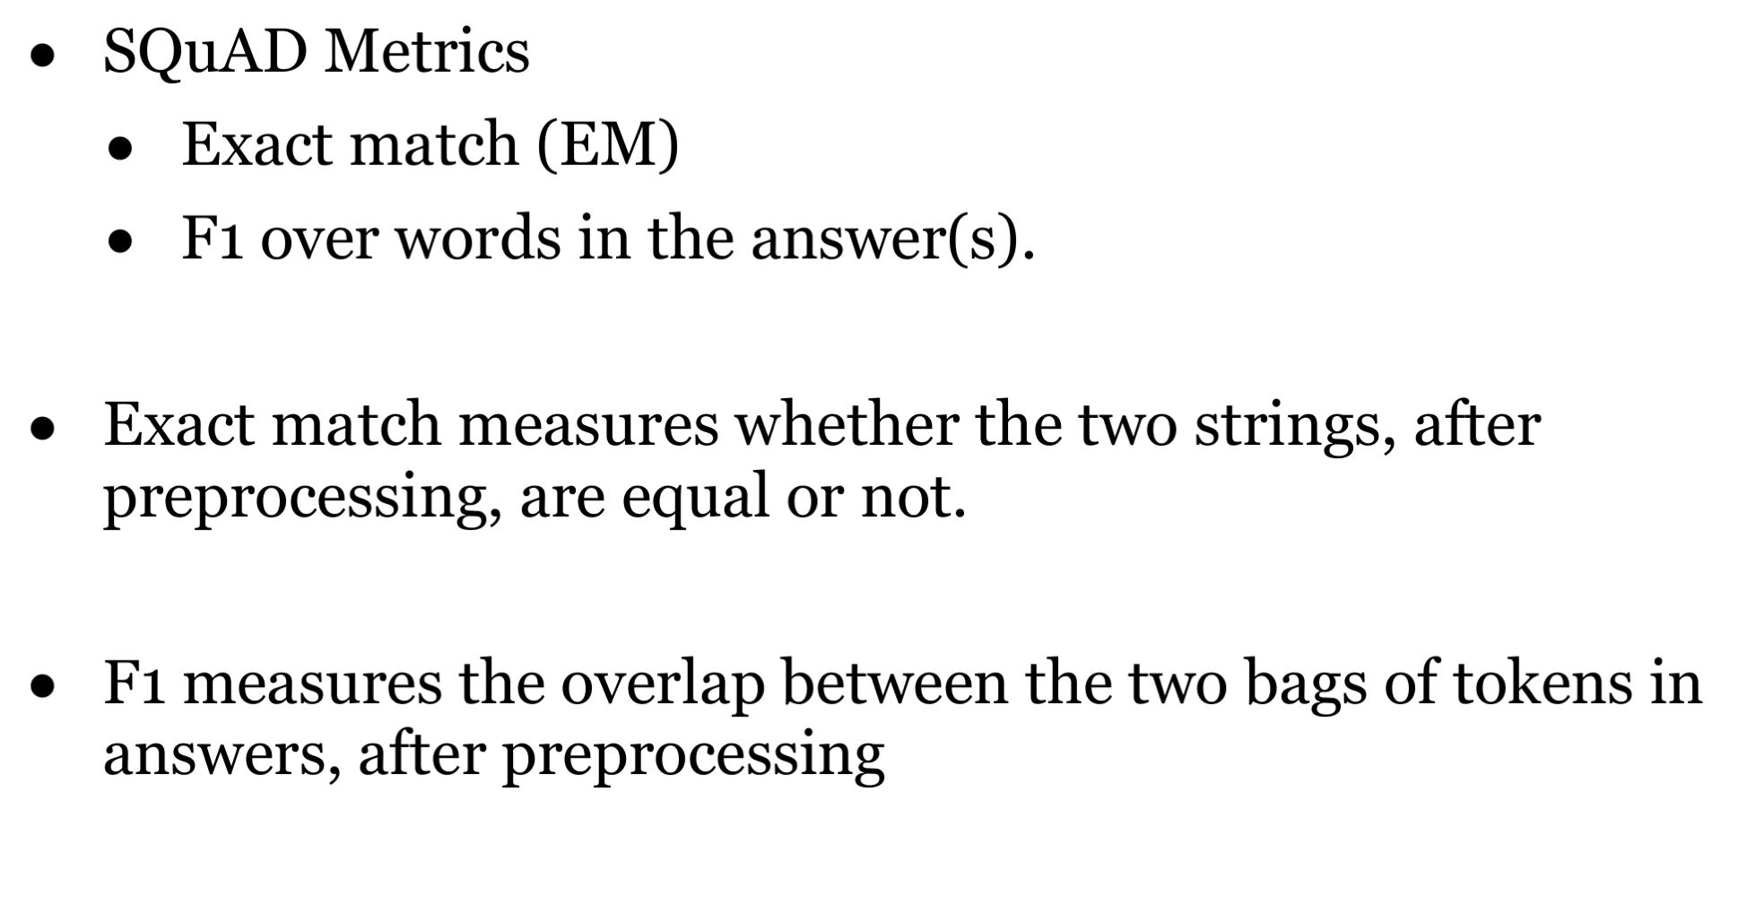
Datasets & Evaluation
https://github.com/danqi/acl2020-openqa-tutorial

Slide 4
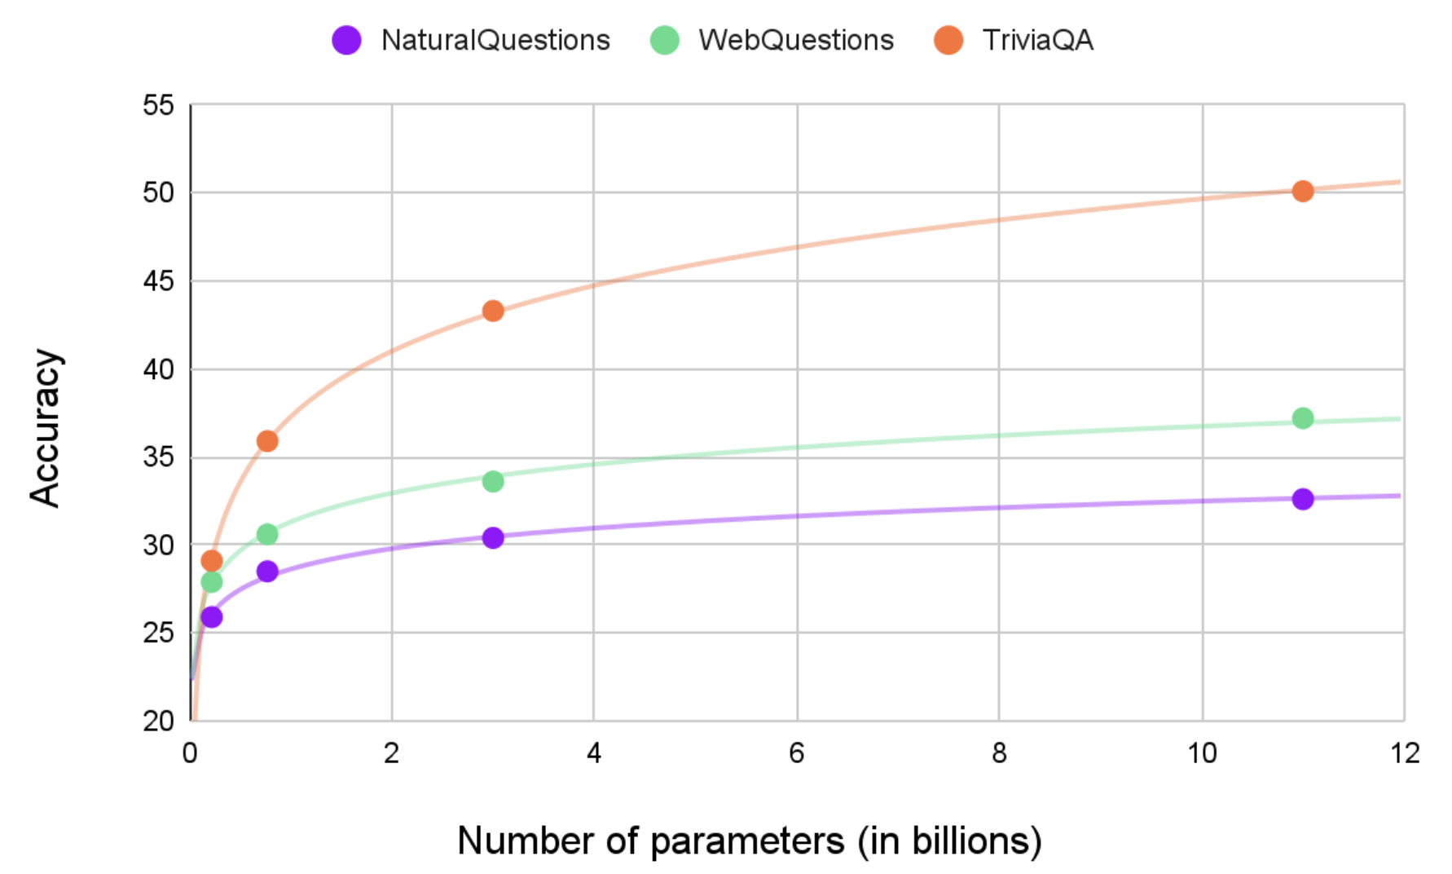
Retriever Free Approaches
Can we use pre-trained language models to act as “knowledge storage”?
The performance is largely impacted by the model size.
T5 on Three Open-domain QA Datasets
How Much Knowledge Can You Pack Into the Parameters of a Language Model? (Adam Roberts, Colin Raffel, Noam Shazeer)

Slide 5
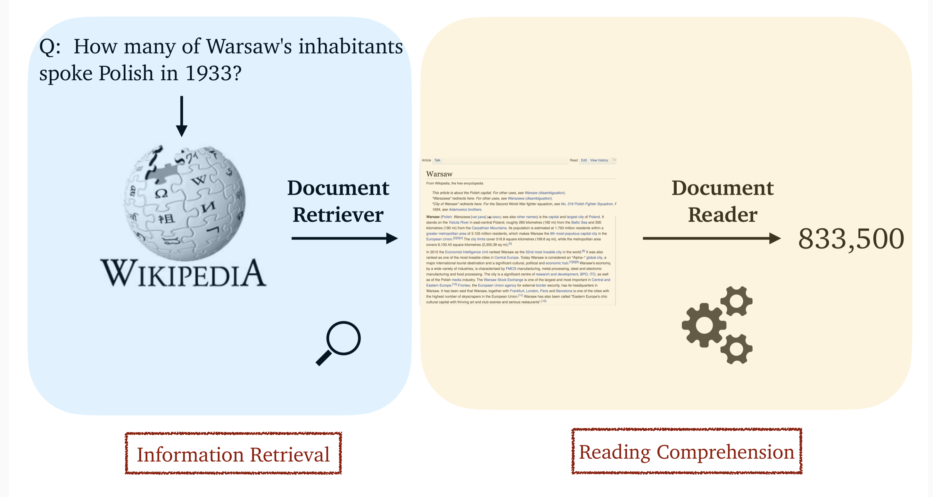
Retriever-Reader Approaches
Can we use small model to achieve better performance than 11B T5 ?
Cast as a reading comprehension problem,
Input a passage and a question.
Output is an Answer.
Using whole WIKIPEDIA (~5millions documents) as external memory.
Reading Wikipedia to Answer Open-domain Questions,Chen et al., 2017.
Notes:
同时也解决了前面提出的两个缺陷，这项工作采用了非自回归的方式去生成图像，所以不存在单一方向的bias
以及采用了Mask和Replace的diffusion策略，引入了Mask Token和随机替换Token，来让模型学习预测mask token以及改正错误的token。在推理阶段，同时计算所有的token的分布，并且根据新的分布进行采样。

Slide 6
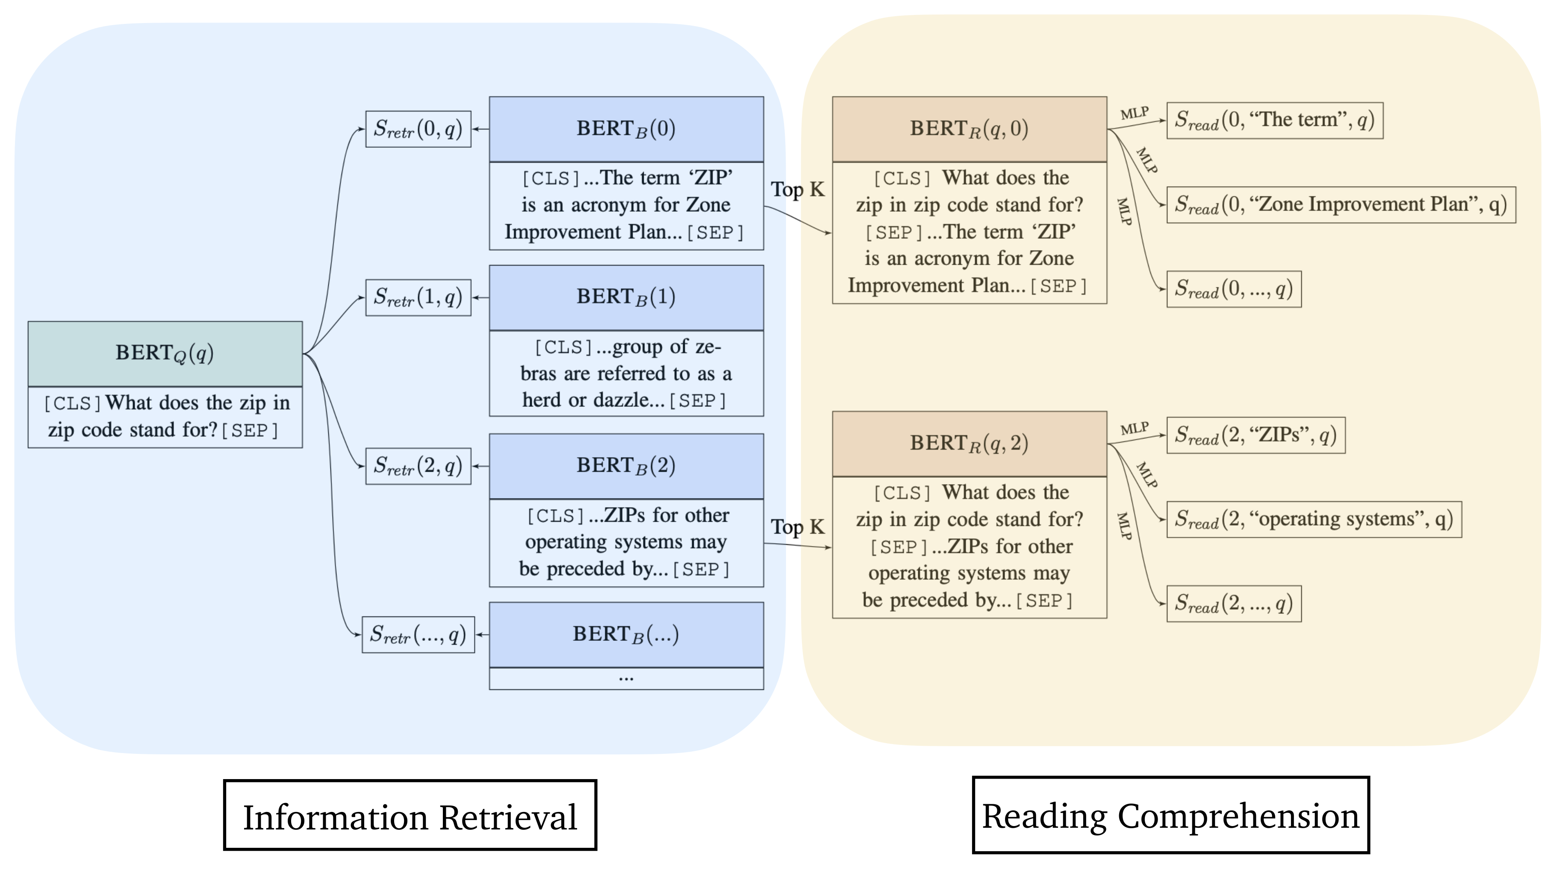
From sparse retriever to dense retriever（ODQA）
ODQA: Continue pretraining Retriever with Inverse Cloze Task.
Latent Retrieval for Weakly Supervised Open Domain Question Answering,Lee et al. 2019
Notes:
With the help of BERT, dense retriever can outperform the sparse retriver, But how to train a dense retriever

Slide 7
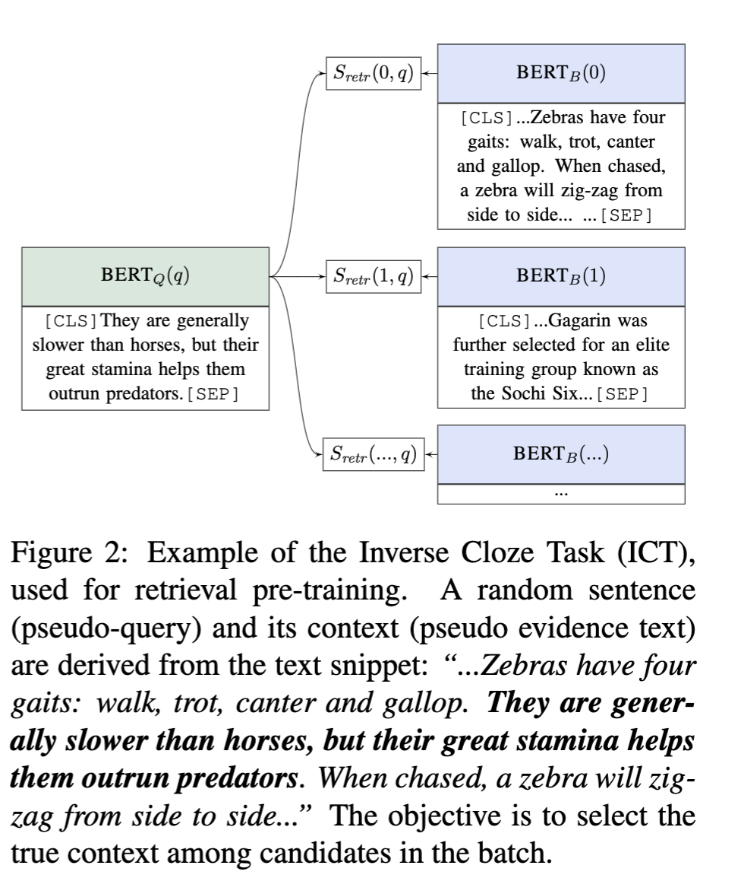
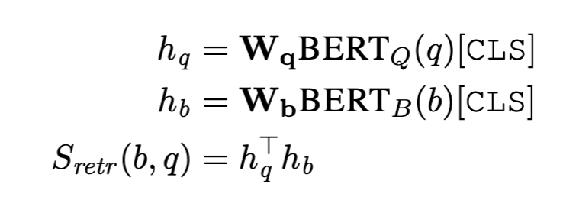
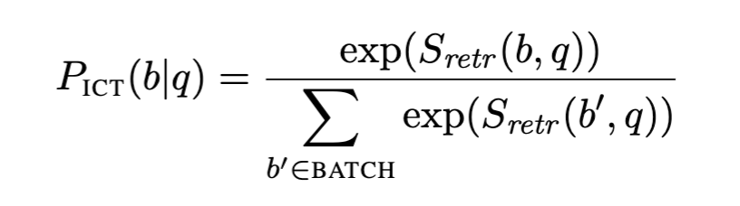
ODQA-Inverse Cloze Task
Giving a sentence, predict its context.
Latent Retrieval for Weakly Supervised Open Domain Question Answering,Lee et al. 2019
Notes:
With the help of BERT, dense retriever can outperform the sparse retriver, But how to train a dense retriever

Slide 8
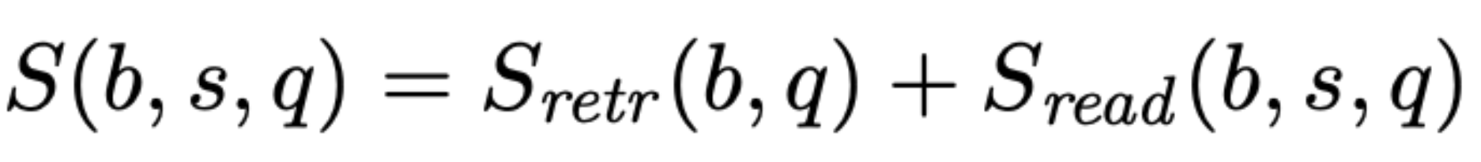
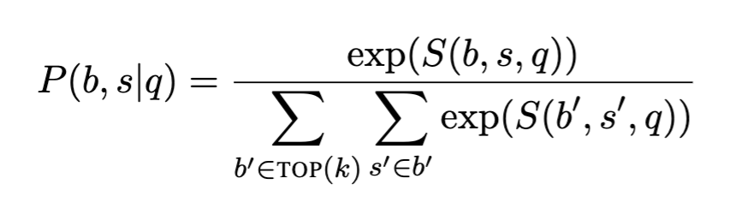
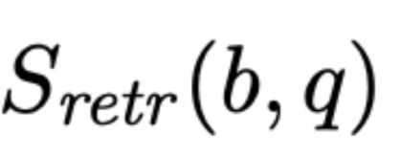
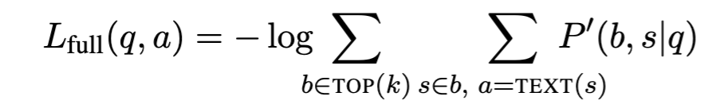
ODQA
Freezing BERT_{B} (Wikipedia Block encoder) and encoding all blocks with BERT_{B}
b - text block, s - a span of text within b, q - question
Top k retrieved blocks according to ,
Latent Retrieval for Weakly Supervised Open Domain Question Answering,Lee et al. 2019
Notes:
With the help of BERT, dense retriever can outperform the sparse retriver, But how to train a dense retriever

Slide 9
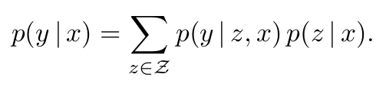
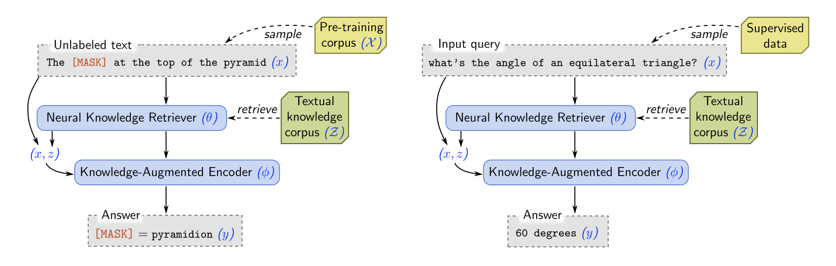
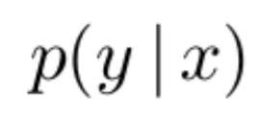
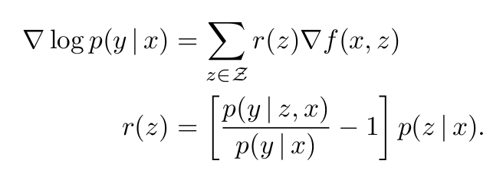
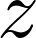
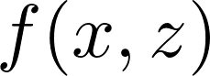
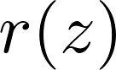
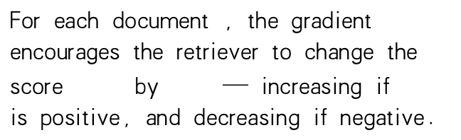
REALM
What does the retriever learn from
retrieval score
For each document , the gradient encourages the retriever to change the score by — increasing if is positive, and decreasing if negative.
Pretraining
Finetuning
Jointly pretraining on both retriever and reader.
REALM: Retrieval-Augmented Language Model Pre-Training,Guu et al. 2020
Notes:
With the help of BERT, dense retriever can outperform the sparse retriver, But how to train a dense retriever

Slide 10
Summary
Both ODQA and REALM need pretraining to get decent dense retriever. However, pretraining this retrievers is very expensive.
Can we train a dense retriever without pretraning?

Slide 11
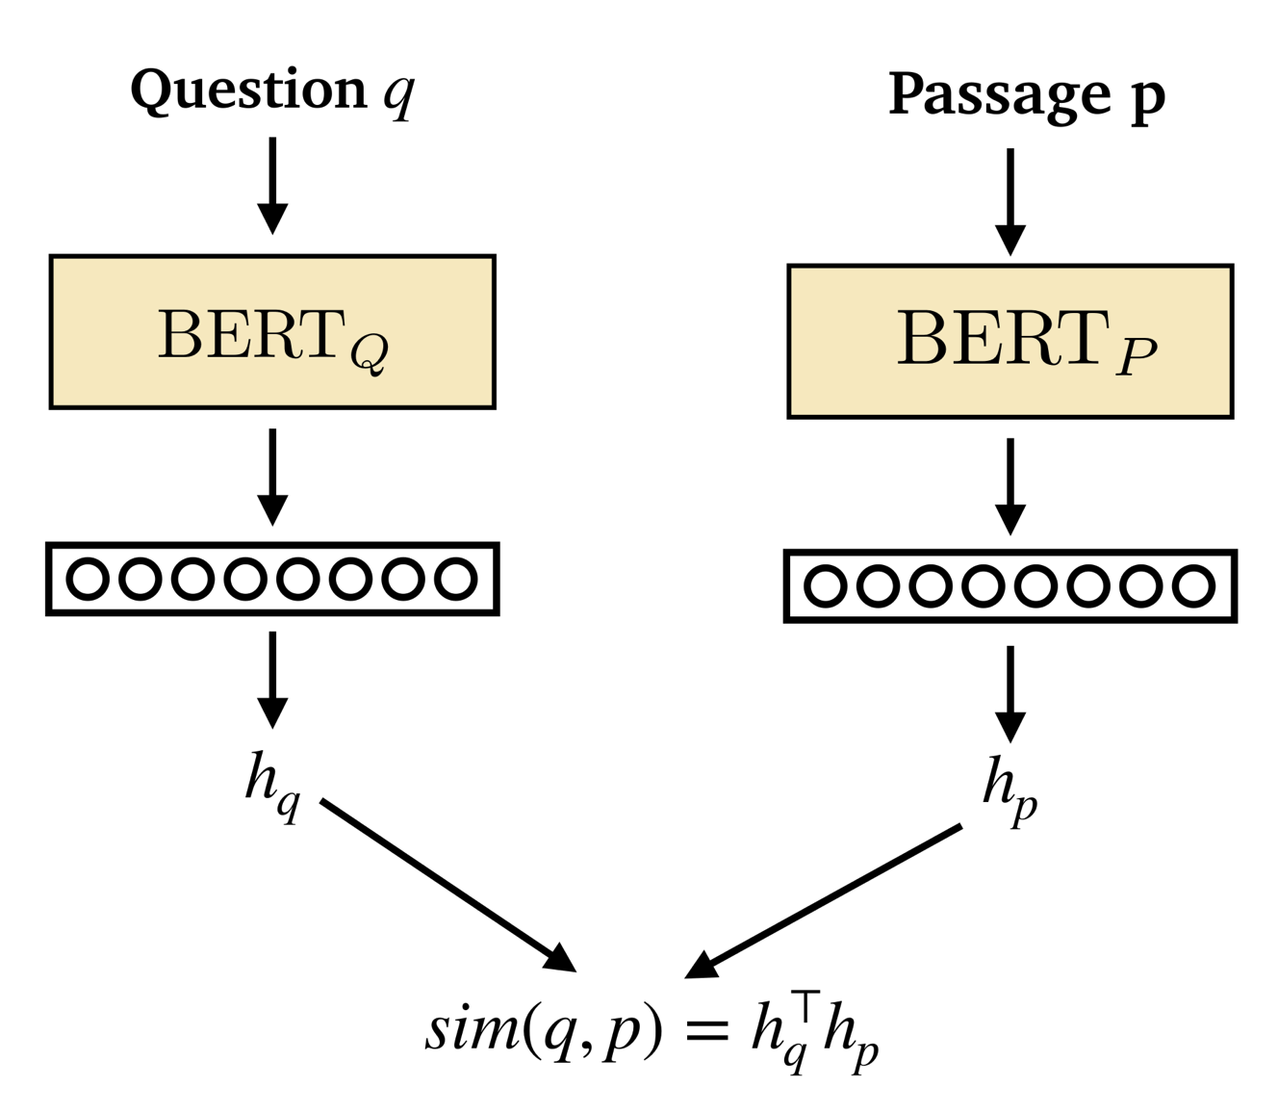
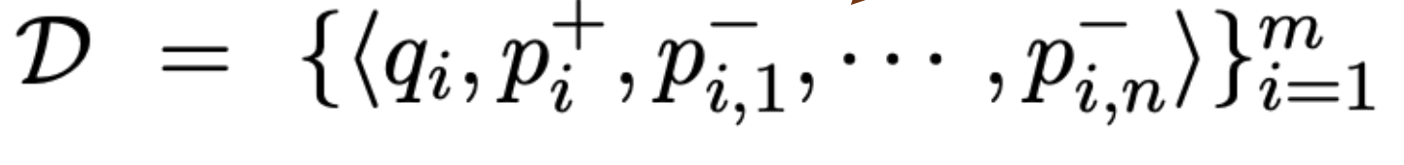
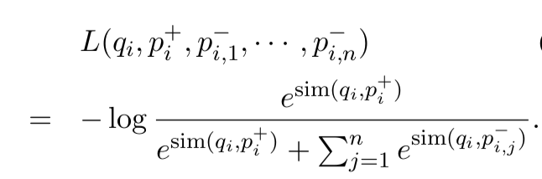
Dense Passage Retrieval (DPR)
Directly training retriever with positive and negative passages.

Slide 12
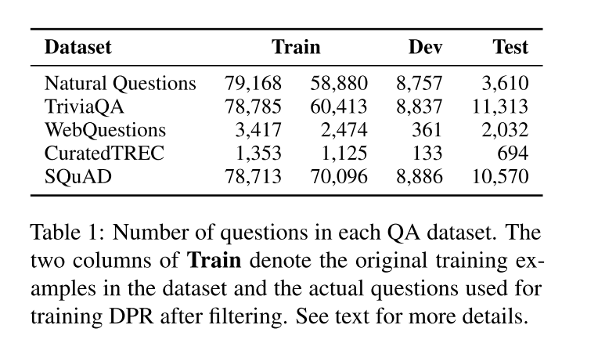
Datasets used in DPR
Because only pairs of questions and answers are provided in TREC, WebQuestions and TriviaQA. We use the highest-ranked passage from BM25 that contains the answer as the positive passage.
For SQuAD and Natural Questions, since the original passages have been split and processed differently than our pool of candidate passages, we match and replace each gold passage with the corresponding passage in the candidate pool.

Slide 13

Datasets used in DPR
We use the English Wikipedia dump from Dec. 20, 2018 as the source documents for answering questions.
Removing semi-structured data, such as tables, infoboxes, lists, as well as the disambiguation pages.
We then split each article into multiple, disjoint text blocks of 100 words as passages, serving as our basic retrieval units, which results in 21,015,324 passages in the end.

Slide 14
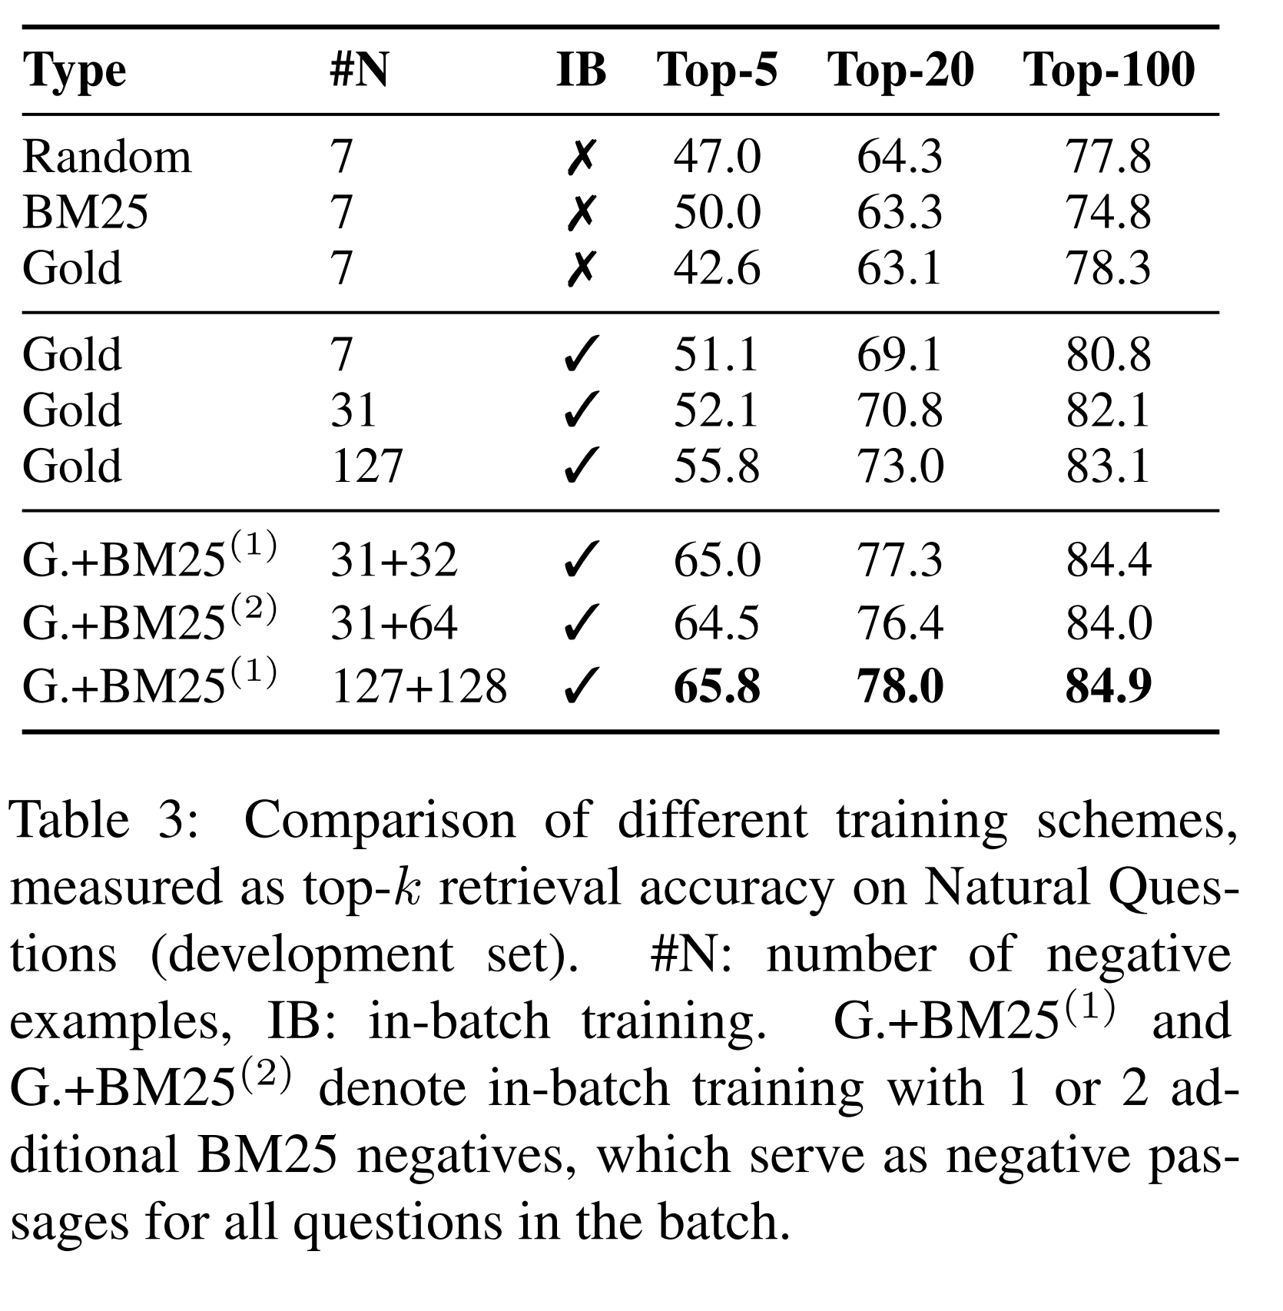
Choose Positive and Negative Samples
Positive
(1) Provided in the reading comprehension datasets
(2) Passages of high BM25 scores that contain the answer string
Negative
(1) Random passages from the corpus (Random)
(2) Passages of high BM25 scores that DO NOT contain the
answer string (BM25)
(3) Positive passages of OTHER questions (Gold)

Slide 15
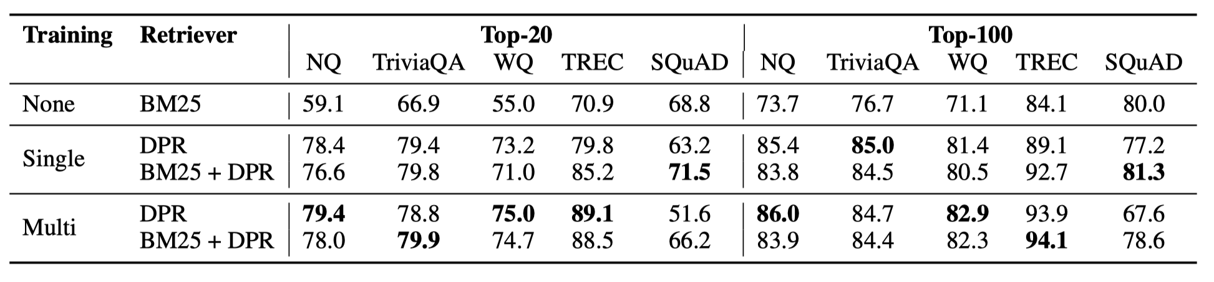
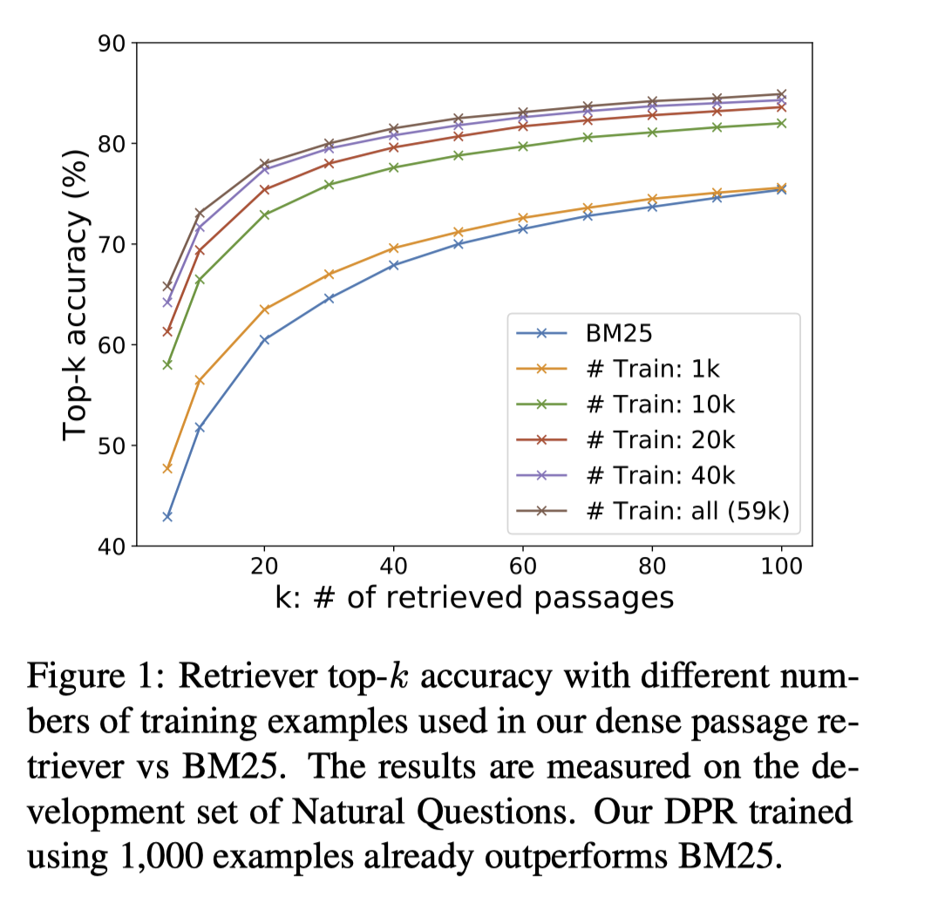
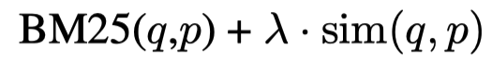
Retriever Performance
BM25+DPR: reranking the we obtain two initial sets of top-2000 passages based on BM25 and DPR, respectively, and rerank the union of them using
Single and Multi: DPR was trained using individial or combined training datasets (all the datasets excluding SQuAD)
1k Q/A pairs beat BM25.

Slide 16
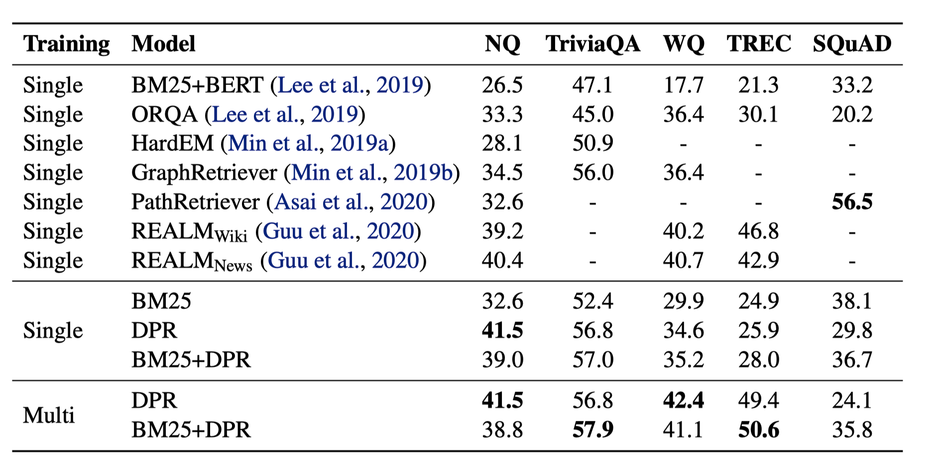
End-to-end QA Performance
DPR is better than REALM on bigger datasets (41.5 vs 39.2 on NQ). For smaller datasets (WebQ, TREC), it needs a mixed training with bigger
datasets to outperform REALM.

Slide 17
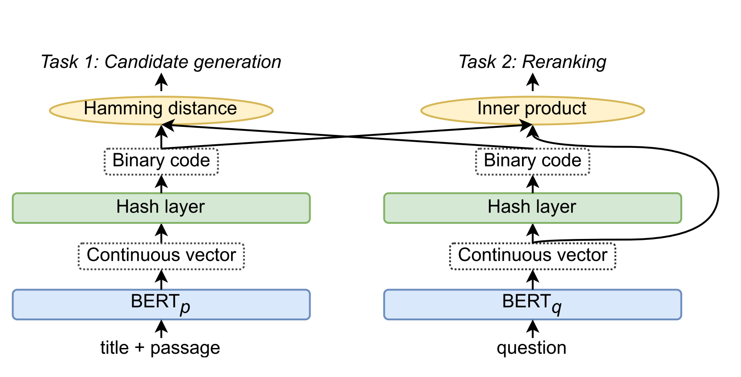
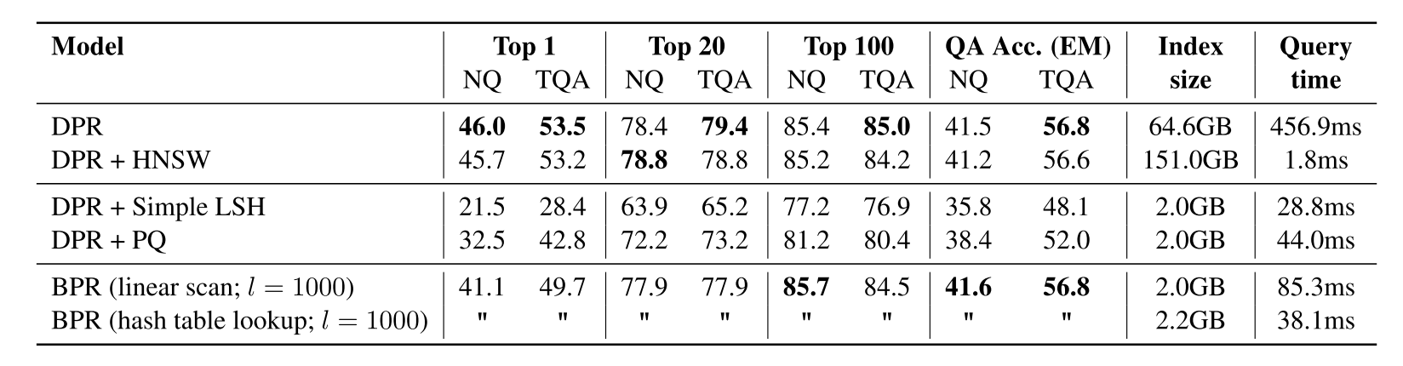
Follow-up Improving Efficient
Binary Passage Retriever (BPR) reduce the memory cost from 65GB to 2GB compare to DPR.
Efficient Passage Retrieval with Hashing for Open-domain Question Answering

Slide 18
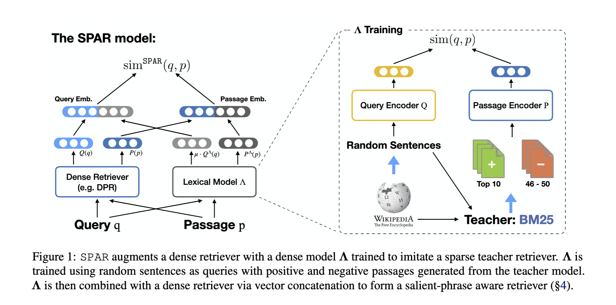
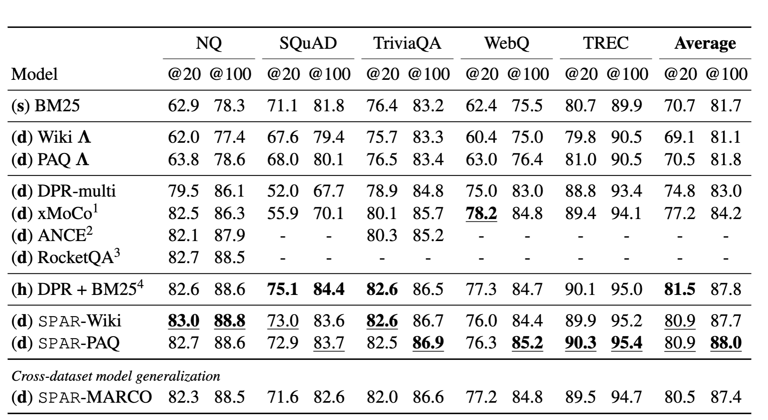
Follow-up Improving Accuracy
Training a dense retriever to imitate sparse retriever.

Slide 19
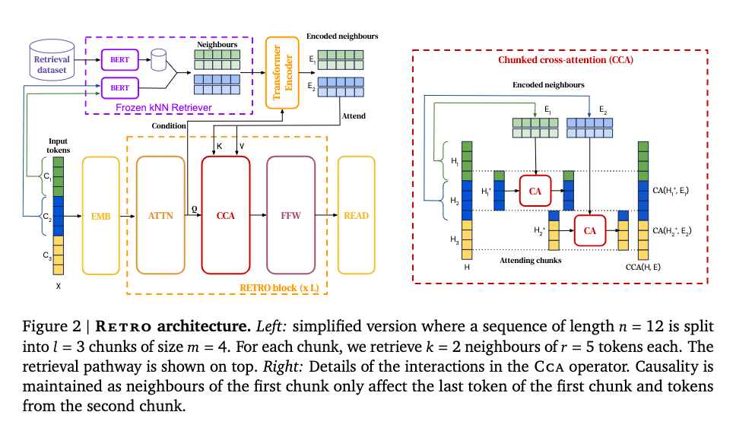
Follow-up Retrieving for Pretraining
RETRO show that retrieving based on a pre-trained frozen Bert model works at scale, removing the need for training and updating a retrievernetwork.
Improving Language Models by Retrieving from Trillions of Tokens

Slide 20
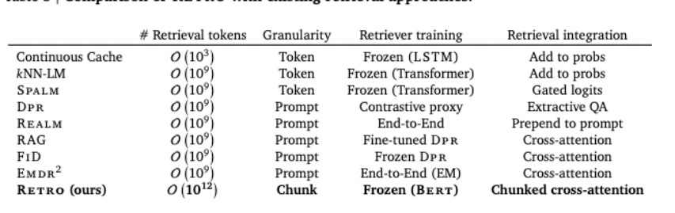
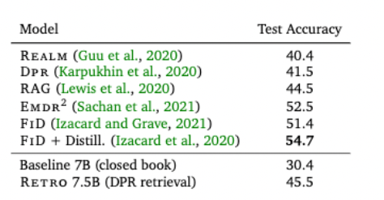
Follow-up Retrieving for Pretraining
Results on NQ, Finetuning RETRO (include retriever) with DRP retrieval datasets.

Slide 21
Thanks.

